Slide 1
University of Illinois REU Introduction to Matlab Day II
Compiled by Erik Huemiller

Slide 2
Goals for Today
Start with
Familiarity using the Matlab interface
Be able to create variables, write and run .m files
Make graphs with code and the GUI
End with
Ability to import data
Plot 2 graphs on the same plot
Fit the data to a function

Slide 3
Resources if you get stuck
Matlab Documentation
Easiest to find through a Google search of “Matlab + command”
There is example code with an explanation of most commands
Links to similar commands are listed at the bottom of the page
BYU Intro to Matlab
Loosely used as an outline for this crash course
PDF with less explicit cross references than the online material
Weitzman Institute
PDF and PPT lectures with slides and example code
Slow moving course designed for people that have never coded before.
Email grad student mentor with questions
Slower response, but can give individual feedback
Can meet up in person to work through a tough problem
Easiest way to find answers about syntax problems or unknown errors

Slide 4
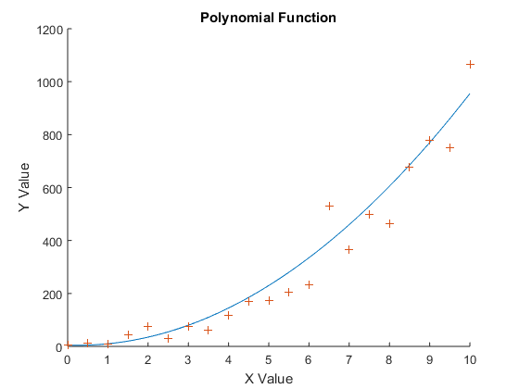
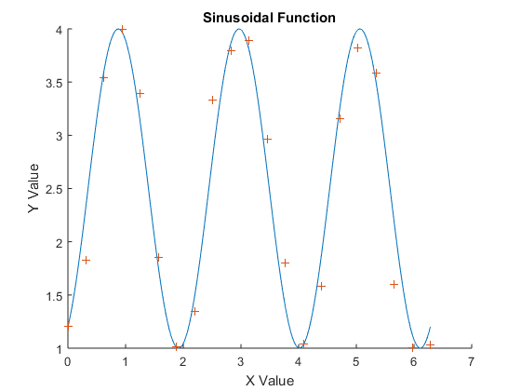
Creating some test Data
Before we get too far into plotting and fitting, we want to have some test data to play around with.
Try to write a program that will create some test data for us to fit functions to. Have 2 sets of data for each function, a low sample rate set with random noise and a high sample rate set to compare the noisy one to. Then plot both of the data sets for each function on the same graph to check that they infact overlap.
Function Types
Polynomial Function
3 periods of a sine function.
You are encouraged to use the commands from yesterday (creating variables, vector manipulation, for loops) to create the data set.

Slide 5
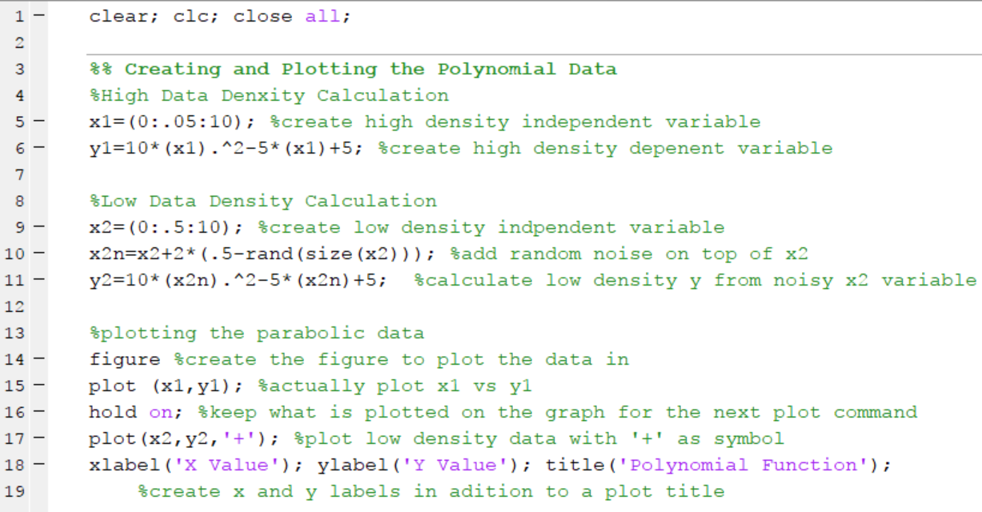
This is what mine looks like Polynomial Function

Slide 6
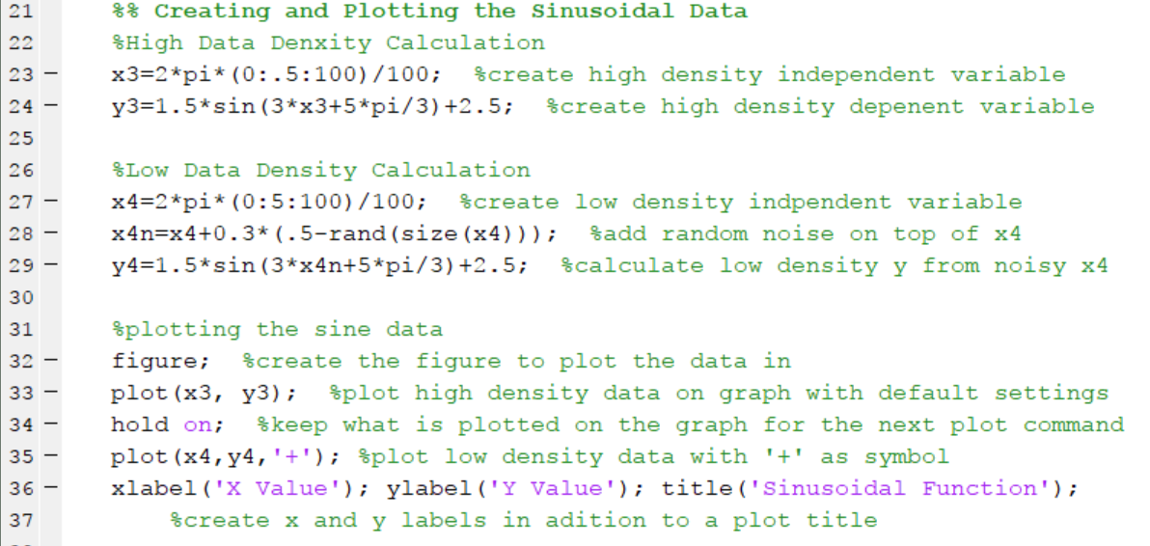
This is what mine looks like Sinusoidal Function

Slide 7
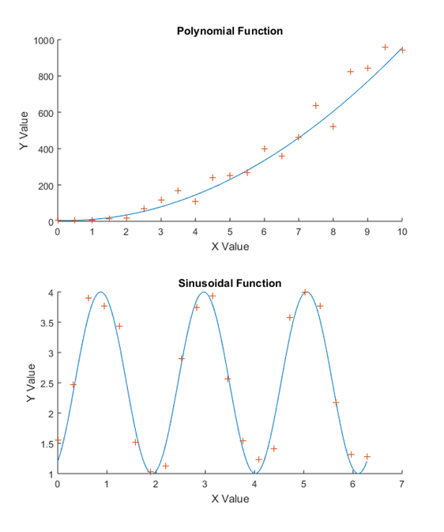
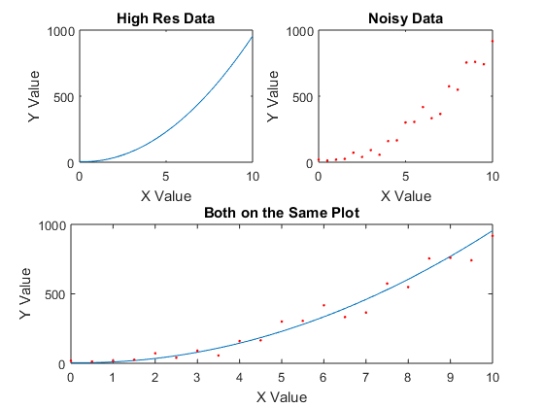
Sub Plots in Figures
In Matlab you can make one figure with multiple plots on it using the subplot command.
There are 3 parts to the command
The Number of columns of graphs
The Number of Rows of graphs
The position you want the next plot command to access
Example Code
figure ;
subplot ( A , B , C ) ;
plot ( x1 , y1 , ’ . ’ ) ;
Try to replicate the figures on the right using the test data you generated earlier today and the subplot command. Don’t forget to add axis labels and titles for each of the graphs.

Slide 8
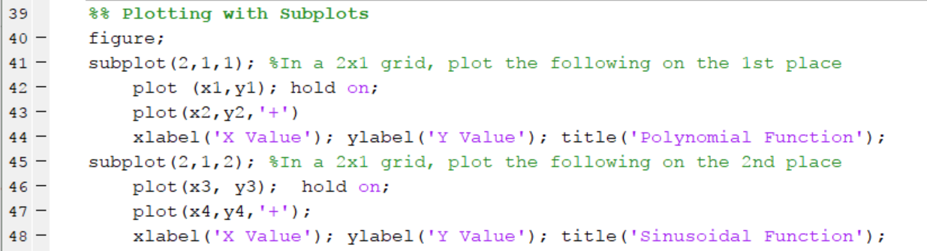
This is what mine looks like Utilizing Sub Plots to make Figures

Slide 9
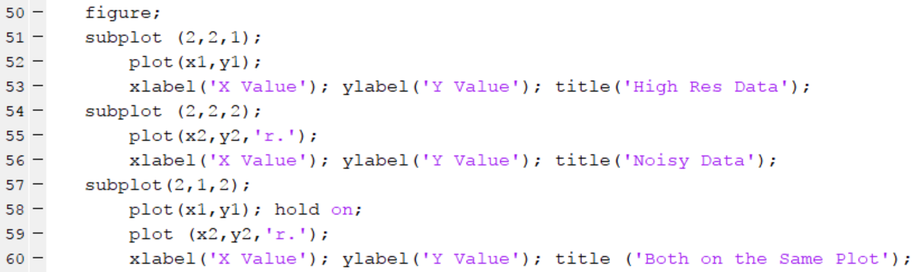
This is what mine looks like 3 Graphs with different geometries in a sub plot

Slide 10
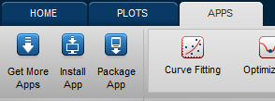
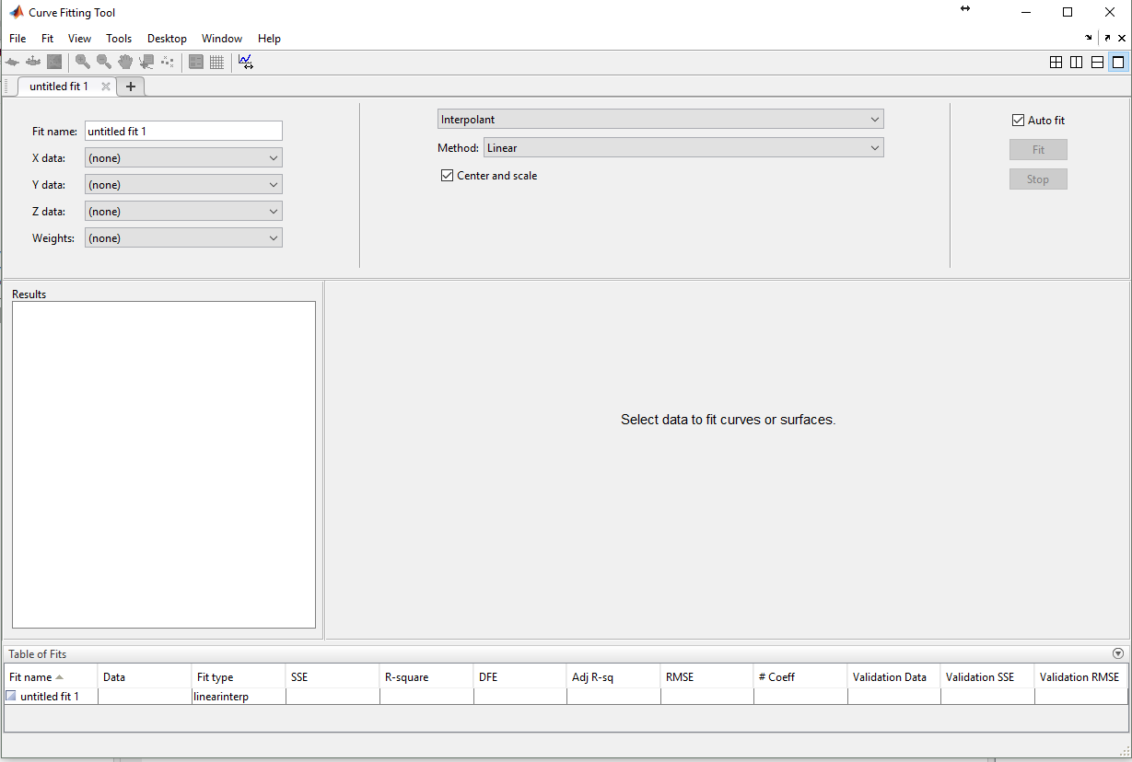
Fitting data to a Function
Using Code
Functional forms commonly used in physics
Polynomial (up to 8)
Sum of Sins (up to 6)
Gaussian (up to 2)
Exponential (up to 3)
Using the GUI
Variables to fit
Fit type
Try setting up a fit to the test data you generated earlier today. Try to extract the coefficients using both code and the GUI and compare them to the values you used to create the data set. How do the residuals compare between the noisy data and the high resolution data?
Fit Parameters
and Residuals
Plot of Data and Fit

Slide 11
This is what mine looks like extracting coefficients from fits to test data

Slide 12
Figuring out test functions
Can you figure out what the coeficients on each of the following functions are?
Have like 10 or 15 functions without noise on them

Slide 13
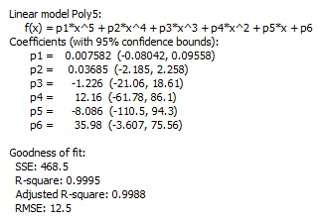
Analyzing the Fit
The Fitting App gives a quality of fit
Try adding more and more random noise to your data and see what happens to the different goodness of fit parameters.

Slide 14
Importing Data
Using Code – Matlab has support for importing a large variety of different file formats (see here). For today we will stick to using csv files (csvread and csvwrite commands).
Like we did yesterday, if you have the data file downloaded you can drag and drop it into the workspace to import the data.
Try downloading the sample functions in the Github folder and figure out what the functions are. If there is extra time, download the Boston marathon Data, and try fitting the outcomes to different functions (histograms to Gaussians etc)

